Slide 1
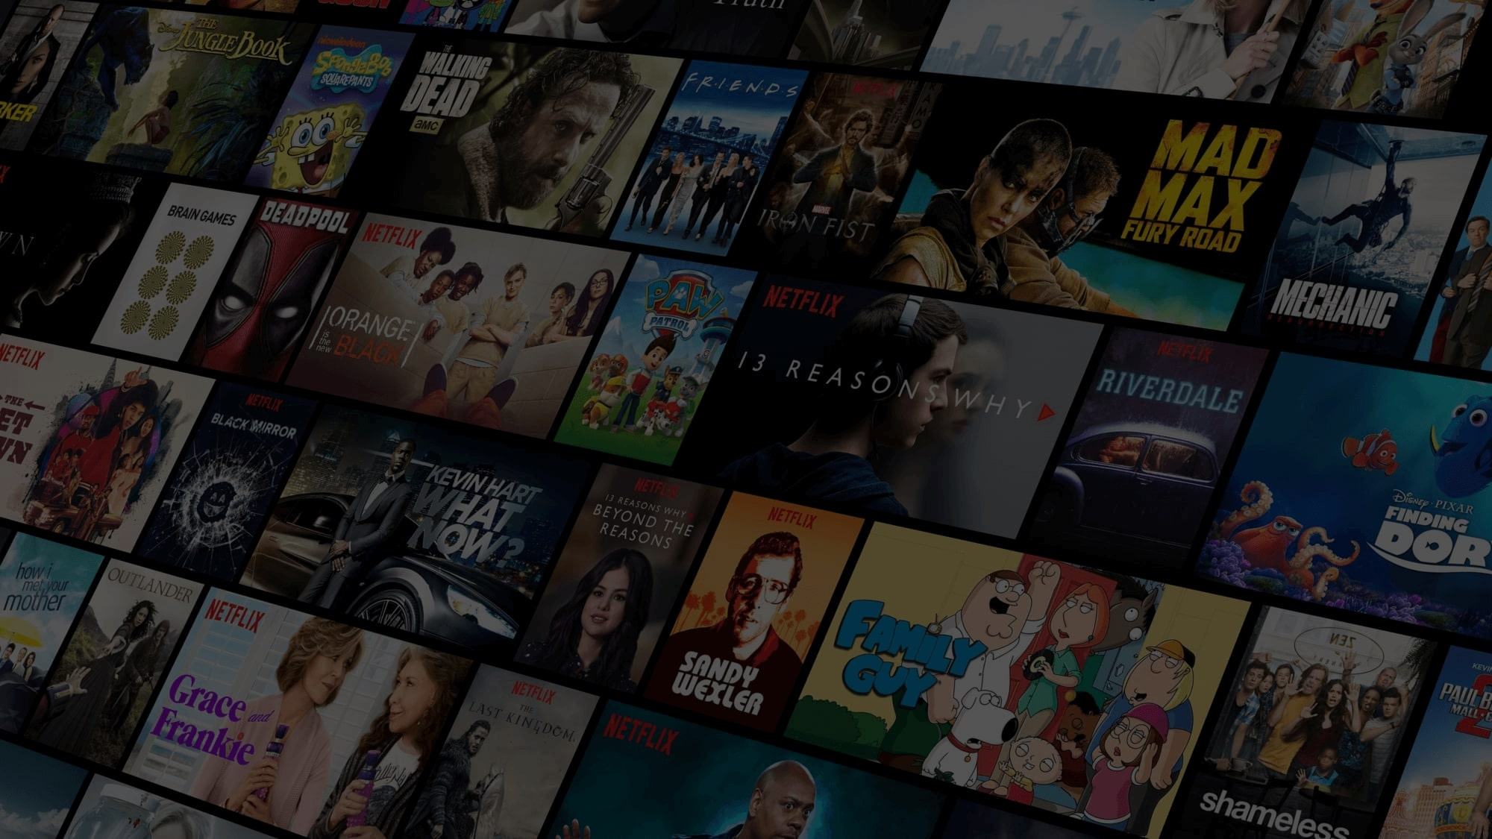



www.moviebutter.biz
Movie Recommender Web application using ML

Slide 2


Why Recommender ?
Points
Have you ever Wondered how Youtube recommends content
How Facebook recommends you,New Friends?
Perhabs you’ve noticed similar Recommendation with the Linkedin connection
How Amazon Recommends the Product while You’re Browsing .All of these Recommendation are made Possible by the implementation of Recommender system.

Slide 3
Why Movie Recommender ?
Points
To obtain recommendations for our users, we will predict their ratings for movies they haven’t watched yet. Movies are then indexed and suggested to users based on these predicted ratings like genres,casting,etc.
To do this, we will use past records of movies and user Interest.

Slide 4
Type of Recommendation System ?
Point
A) Content-Based Movie Recommendation Systems.
B) Collaborative Filtering Movie Recommendation Systems.

Slide 5
Softwares Requirements.
Data set of movies with titles,genres,cast,etc
Python Libraries like numpy and Pandas .
Python Web framework
Jupyter Notebook for Project Building.
Deployment System

Slide 6


Get In Touch
Email
aranav1289@gmail.com
Social Media linkedin
@aranavmahalpure
Call us
+91 9975659711

